Slide 1


Mech-Fuel
Fuel And Mechanical Support For Emergencies

Slide 2


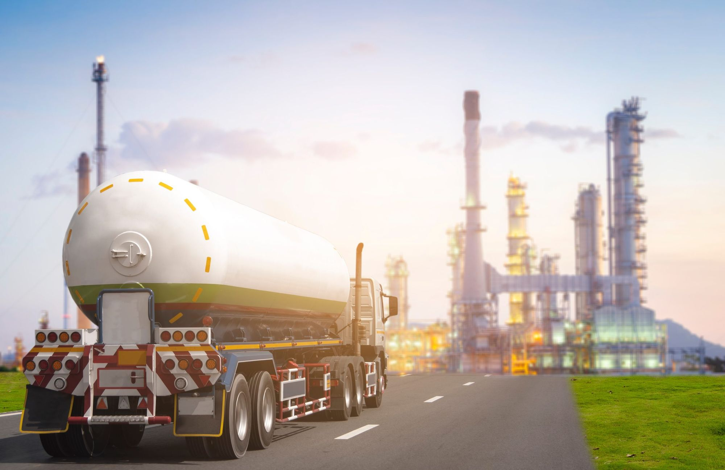
Introduction To Mech-Fuel :
In emergency situations, reliable fuel supply and mechanical support are crucial for ensuring uninterrupted operations.
Whether for stranded vehicles, industrial machinery, or critical infrastructure, emergency fuel and repair services help prevent downtime, financial losses, and safety risks. Key Applications: Roadside assistance for vehicles

Slide 3
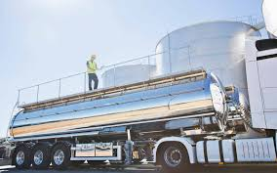
Importance of Emergency Fuel & Mechanical Support :
Ensures Operational Continuity : Critical sectors like healthcare, transport, and power generation depend on uninterrupted fuel supply.
Reduces Downtime : Quick mechanical fixes prevent long delays and potential revenue losses.
Supports Disaster Response : Emergency fuel and mechanical assistance aid rescue teams during natural disasters and crises.
Enhances Safety : Properly maintained vehicles and equipment reduce accidents and failures.

Slide 4
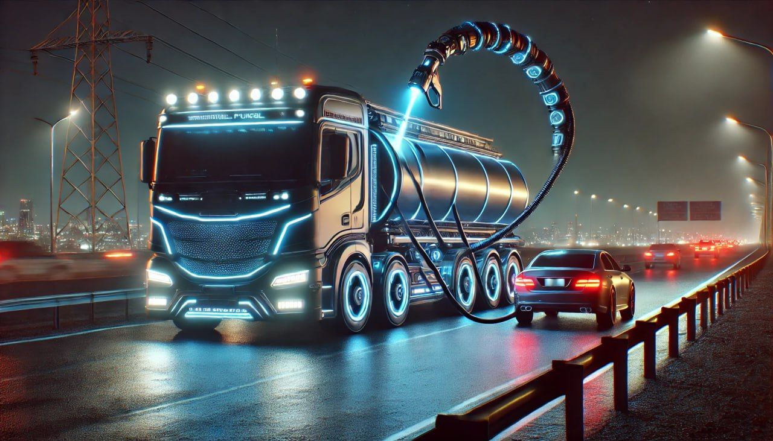
Types of Emergency Fuel Supply
Mobile Fuel Delivery : Fuel tankers deliver diesel, petrol, or aviation fuel to stranded vehicles or sites.
Backup Fuel Storage : Fuel reserves are maintained for critical operations, such as hospitals and data
centers.
Alternative Fuel Solutions : Biodiesel, propane, and hydrogen fuel for sustainable emergency power.

Slide 5

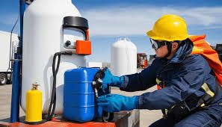
Fuel Safety & Compliance :
Fire Prevention : Fire extinguishers, spill control measures, and ventilation systems.
Fuel Transport Regulations : Adherence to ADR, OSHA, and local transportation laws.
Environmental Protection : Proper disposal of fuel waste, s. containment strategies

Slide 6
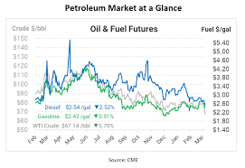
Servey Of Existing Website/Web App :
Purpose : Evaluate Mech-Fuel’s website/web app to improve user experience, functionality, and performance.
Target Audience : Mechanics, automotive enthusiasts, or businesses looking for fuel-related services/products.
Key Metrics : User engagement, conversion rates, technical performance, and customer satisfaction.

Slide 7


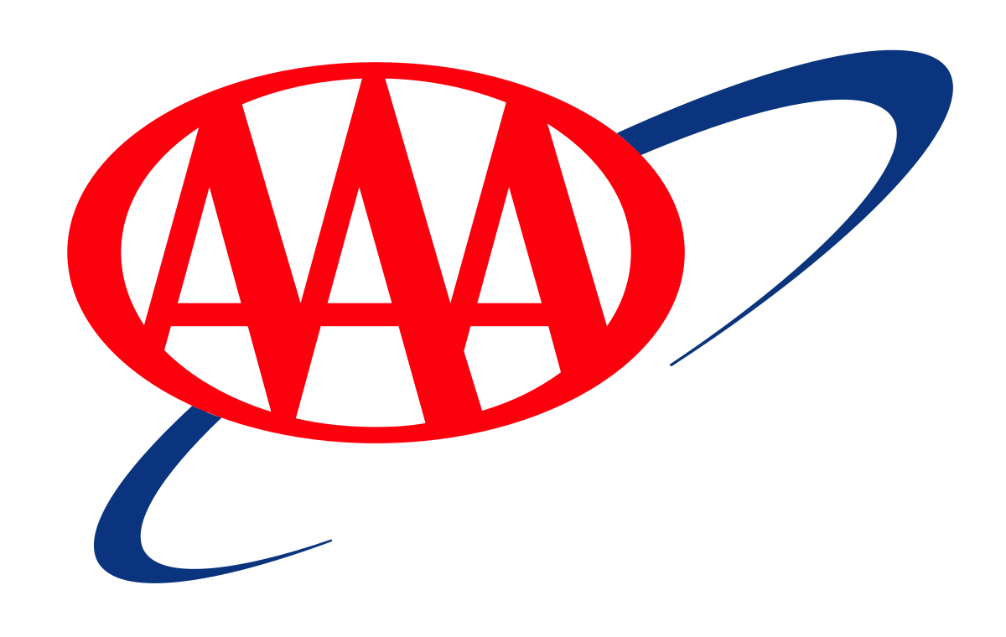

We've meticulously analyzed existing platforms like YourMechanic, AAA, and GasBuddy to identify their strengths and weaknesses. This helped us pinpoint opportunities for MECH-FUEL to stand out.

Slide 8
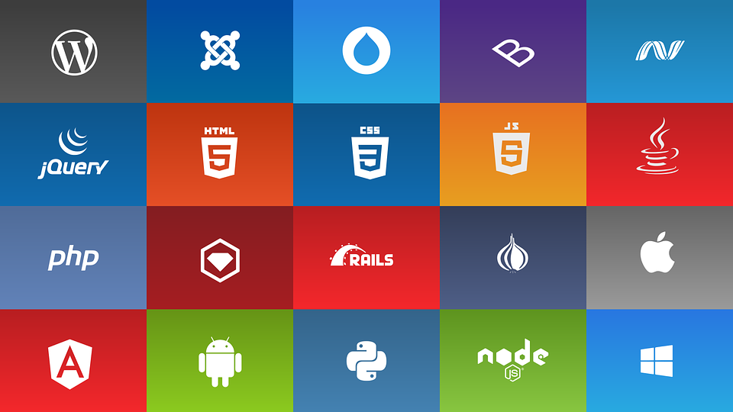

Technology Stack
Hypothetical Tech Stack could be used:
Frontend (Client-Side) :
Framework : React.js or Angular (for dynamic, interactive user interfaces).
Styling : CSS3, SASS, or Tailwind CSS (for responsive and modern design).
State Management : Redux or Context API (for managing application state).
Routing : React Router or Angular Router (for navigation between pages).
UI Components : Material-UI or Bootstrap (for pre-built, customizable components).

Slide 9


Backend (Server-Side) :
Language : Node.js (with Express.js) or Python (with Django/Flask) Or Java (SpringBoot) for scalable backend development.
Database : Relational : PostgreSQL or MySQL (for structured data like user accounts, orders, etc.).
NoSQL : MongoDB (for flexible data storage, e.g., product catalogs).
API : RESTful API or GraphQL (for communication between frontend and backend).
Authentication : JWT (JSON Web Tokens) or OAuth (for secure user login and authorization).

Slide 10
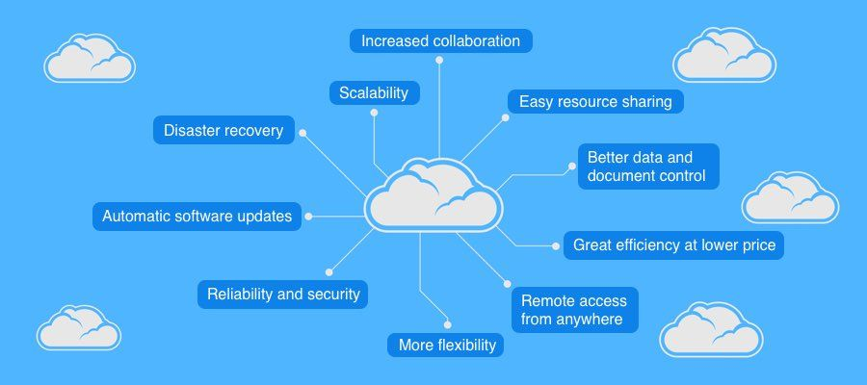
Why To Use This Stack
We use this stack to make sure about :
Scalability : Node.js and cloud hosting allow Mech-Fuel to handle growing traffic and user demands.
Flexibility : React and GraphQL enable a dynamic and responsive user interface.
Security : JWT and HTTPS ensure secure user authentication and data transmission.
Cost-Effectiveness : Open-source technologies like React, Node.js, and PostgreSQL reduce licensing costs.

Slide 11
Design and Architecture (MVC)
MVC (Model-View-Controller) pattern is a great approach to ensure a clean, modular, and scalable structure.
Model (Data and Business Logic) :
The Model represents the data and business logic of Mech-Fuel. It interacts with the database and performs operations like data validation, calculations, and business rules.
Entities :
User : Manages user data (e.g., name, email, password, role).
Product : Represents fuel-related products (e.g., fuel types, additives, tools).
Order : Handles order details (e.g., order ID, user ID, product ID, quantity, status).
Payment : Manages payment transactions (e.g., payment ID, order ID, amount, status).
Blog/Content : Stores blog posts, guides, or tutorials related to automotive fuel.

Slide 12
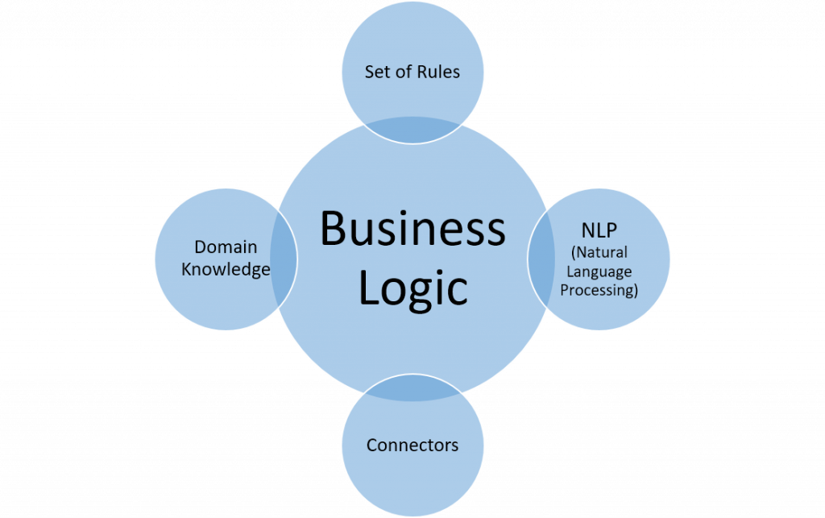

Database :
Relational Database: PostgreSQL or MySQL for structured data.
NoSQL Database: MongoDB for flexible data storage (e.g., product catalogs).
Business Logic :
Calculate fuel efficiency or cost based on user input.
Validate user credentials during login.
Process payments and update order status.

Slide 13

View (Presentation Layer) :
The View is responsible for displaying data to the user and capturing user input. It is the UI of Mech-Fuel.
Pages :
Home Page : Displays featured products, promotions, and navigation links.
Product Listing Page : Shows a list of fuel products with filters (e.g., by type, price).
Product Detail Page : Displays detailed information about a specific product.
Cart/Checkout Page : Allows users to review their cart and proceed to payment.
User Dashboard : Displays user profile, order history, and saved items.
Blog/Resource Page : Shows articles, guides, or tutorials.
Technologies :
Frontend Framework : React.js or Angular for dynamic and interactive UI.
Styling : CSS3, SASS, or Tailwind CSS for responsive design.
UI Components : Material-UI or Bootstrap for pre-built components.

Slide 14
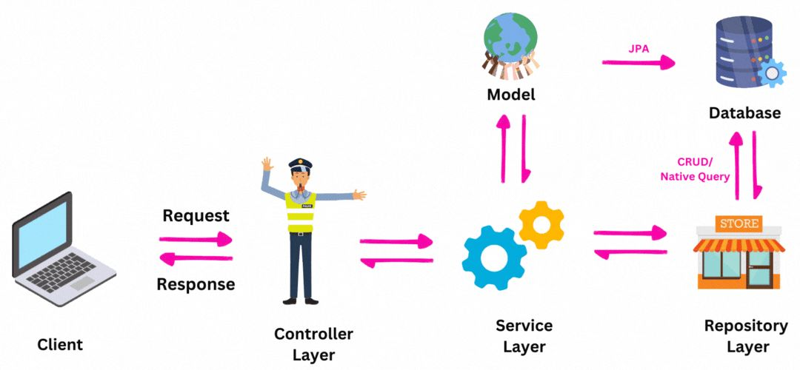
Controller (Application Logic) :
The Controller handles user input, processes requests, and updates the Model or View accordingly. It acts as the bridge between the Model and View.
Routes :
User Routes :
/register: Handles user registration.
/login: Manages user login and authentication.
/profile: Fetches and updates user profile data.
Product Routes :
/products: Fetches a list of products.
/products/:id: Fetches details of a specific product.
Order Routes :
/cart: Manages the user’s shopping cart.
/checkout: Processes the checkout and payment.
/orders: Fetches the user’s order history.
Blog Routes :
/blog: Fetches a list of blog posts.
/blog/:id: Fetches a specific blog post.
Functions :
Validate user input (e.g., during registration or login).
Fetch data from the Model and pass it to the View.
Handle errors and display appropriate messages to the user.

Slide 15
Features And Functionality
Features of Mech-Fuel :
High Energy Density :
Mech-Fuel could be designed to store a large amount of energy in a compact form, making it ideal for powering heavy machinery or long-duration operations.
Efficiency :
It might offer high conversion efficiency, ensuring minimal energy loss during use, which is critical for mechanical systems requiring sustained power.
Sustainability :
If aligned with modern trends, Mech-Fuel could be eco-friendly, using renewable resources or producing minimal emissions.
Safety :
Safety features might include non-toxicity, low flammability, and secure storage options to prevent accidents.

Slide 16
Functionality of Mech-Fuel :
Power Generation :
Mech-Fuel could serve as a primary energy source for mechanical systems, converting chemical or other forms of energy into mechanical work.
Energy Storage :
It might act as a storage medium, allowing energy to be saved and used on demand, similar to batteries or fuel cells.
Portability :
Mech-Fuel could be designed for easy transport and refueling, making it ideal for mobile applications like vehicles or portable machinery.
Integration with AI and Automation :
In advanced systems, Mech-Fuel might integrate with AI-driven machinery to optimize energy usage and performance.
Multi-Purpose Use :
It could be versatile, powering a range of devices from industrial robots to autonomous vehicles or even space exploration equipment.

Slide 17
Development Workflow
Conceptualization and Research :
Define Objectives :
Identify the purpose of Mech-Fuel (e.g., powering robots, vehicles, or industrial machinery).
Determine key performance metrics (e.g., energy density, efficiency, sustainability).
Market Research :
Analyze existing solutions and identify gaps or opportunities.
Stakeholder Input :
Gather requirements from end-users, engineers, and business stakeholders.
Design and Prototyping :
System Design :
Create a high-level architecture for the Mech-Fuel system.
Define components (e.g., fuel storage, energy conversion, control systems).
Prototype Development :
Build a small-scale prototype to test the core functionality.

Slide 18
Testing and Validation :
Laboratory Testing :
Test the prototype in controlled environments to measure performance metrics.
Field Testing :
Deploy the prototype in real-world scenarios to evaluate practicality and durability.
Safety Testing :
Ensure compliance with safety standards and regulations.
Iterative Improvement :
Refine the design based on test results and feedback.
Maintenance and Updates :
Regular Maintenance :
Provide support for system upkeep and troubleshooting.
Software Updates (if applicable) :
Update control algorithms or software for improved performance.
Feedback Loop :
Use user feedback to identify areas for improvement.

